Slide 1

TasteTrove: A Web-Based Application For Finding Everyday Meals With Taste And Nutrition.
Real -Time/Field-Based Research Project Review-2 Presentation
by
M.DILEEP KRISHNA-23B81A0576
B.NIHAN REDDY-23B81A0589
B.PRAJEETH REDDY-23B81A0592
Section:B
Batch No:9
Dept:CSE
CVR College of Engineering

Slide 2
Abstract
To develop an intuitive web-based recipe discovery platform that empowers users to find, cook, and enjoy healthy meals with ease.
Combines culinary creativity with nutritional science.
Enhances meal planning through advanced search, personalization, and macro-nutrient guidance.
TasteTrove simplifies home cooking through recipe discovery based on ingredients, diet type, and preferences.
Provides recipe details, ingredients and cooking timer.
Aims to make healthy, home-cooked meals accessible and enjoyable for all.

Slide 3
Problem definition
More people are choosing ready-made food because they don’t know much about nutrition and are often short on time.
Healthy food is perceived as time-consuming or tasteless.
No unified platform providing recipes with nutritional guidance and ease of use.
Solution: A simplified interface offering informative, personalized meal options.

Slide 4
Software Requirement Specification
Functional Requirements:
Recipe search & filters
Detailed recipe pages
Add recipes (logged-in users)
Cooking timer (logged-in users)
Non-functional Requirements:
Usability, performance, scalability, cross-platform compatibility.
Hardware Requirements:
Min. 2 GHz dual-core processor, 4GB RAM, stable internet

Slide 5
Software Requirement Specification
User Requirements:
Guest Access – Users can view recipes without logging in.
Search & Filters – Find recipes by name, ingredients, or type (veg, non-veg, sweets).
Recipe Details – View ingredients, steps, and nutrition info for each recipe.
Registered Features – Logged-in users can add recipes and use a cooking timer.
User-Friendly Design – Works on all devices, with simple interface and dark mode support.

Slide 6
Outline
1.Proposed methodology
(Architecture/Model/DFDs/ Algorithms)
2.System design
Structural diagrams (Class, Object, Component, Deployment)
Behavioral diagrams( Use case, sequence, collaboration ,activity, state chart diagrams)
3. Implementation – Module description
4. Coding
5. Results
References

Slide 7
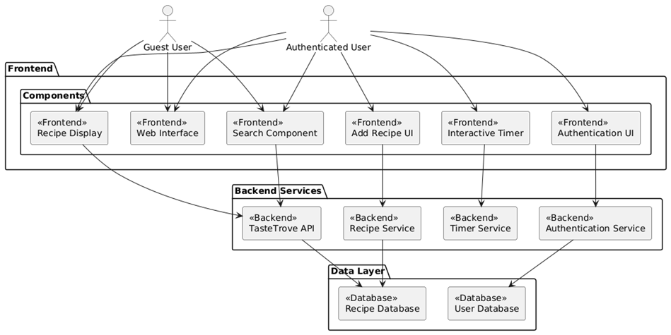
1.Proposed methodology
TasteTrove Architecture

Slide 8
1.Proposed methodology
No login needed for guest access.
Simple UI with ingredient-based recipe search.
Advanced search filters (veg, non-veg, sweets).
Recipes with macronutrient info.
Firebase used for real-time backend & authentication

Slide 9
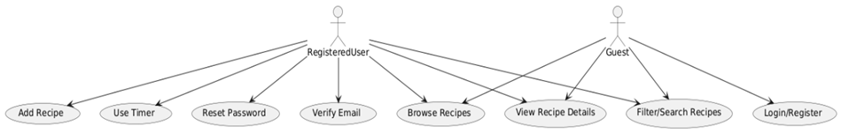
2.System design
Structural Diagrams:
Use Case Diagram

Slide 10
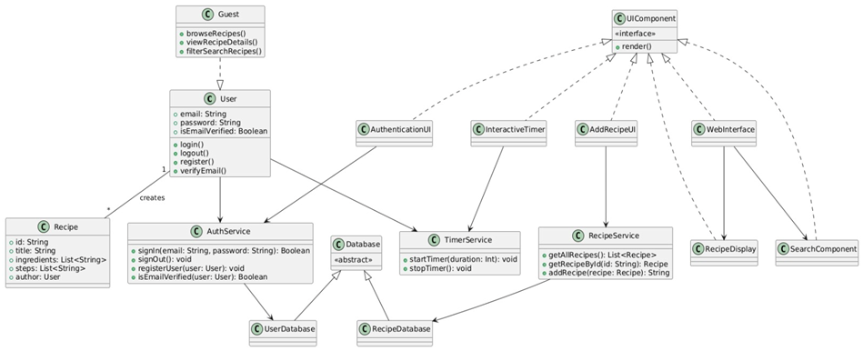
2.System design
Class Diagram

Slide 11
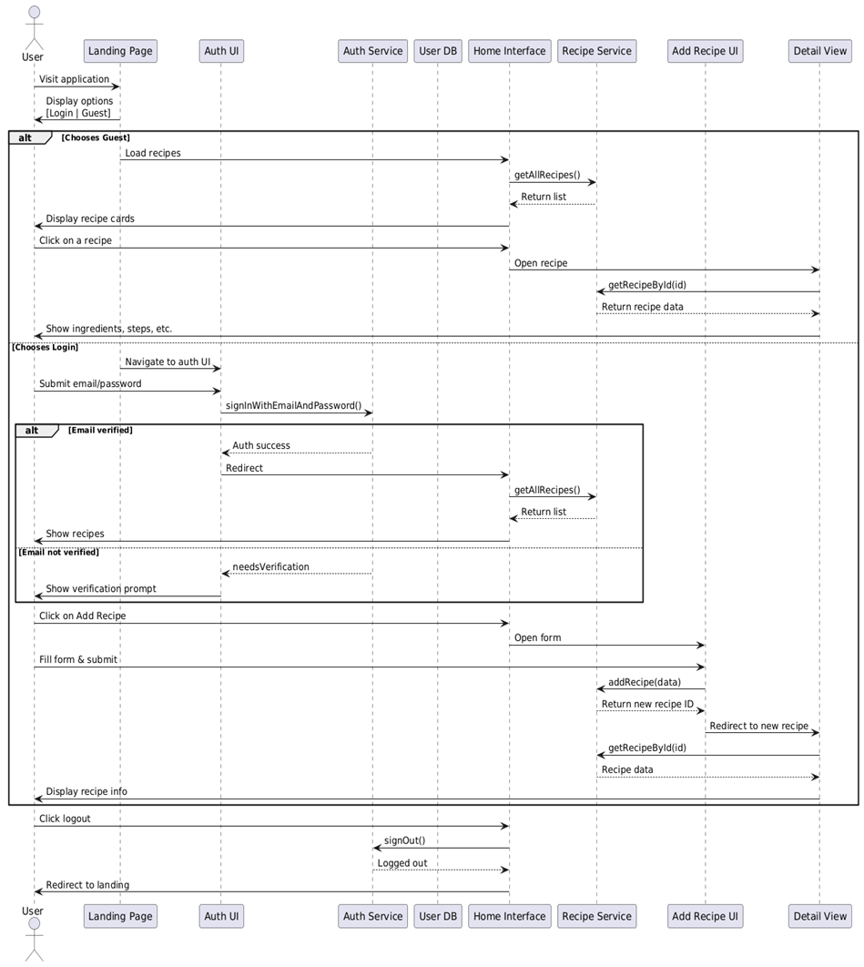
2.System design
Sequence Diagram

Slide 12
3. Implementation – Module description
3.1 Guest Mode:
Users can access the site without logging in.
They can browse, search, and filter recipes easily.
Full recipe details, including ingredients and instructions, are visible.
Interactive features like the cooking timer and recipe submission are restricted.
If they try accessing these features, they're prompted to log in.

Slide 13
3. Implementation – Module description
3.2User Mode:
Registered users can log in with email verification.
They can access all guest features plus add new recipes.
An interactive cooking timer is available for step-by-step cooking.
Users can manage their submitted recipes and receive real-time feedback.
This mode provides a more personalized and engaging cooking experience.

Slide 14
4. Results ( Expected output)
Seamless browsing experience for users.
Interactive cooking timer to aid real-time cooking.
Reliable access control (guest vs registered user).
Consistent performance with smooth navigation.

Slide 15
References
Articles & Web Sources:
MDN Web Docs – HTML, CSS, JavaScript
Firebase Documentation – Realtime Database, Cloud Firestore
W3Schools – Responsive Web Design
USDA FoodData Central – Nutrient Database
Vismai Food – Authentic Telugu Recipes

Slide 16
References
Academic References:
Jakubowicz, D., & Wainstein, J. (2018). The Impact of Nutritional Education on Home Cooking Practices: A Web-Based Approach. Nutrition & Dietetics, 75(4), 423–430.
Fowler, M. (2003). UML Distilled: A Brief Guide to the Standard Object Modeling Language (3rd ed.). Addison-Wesley.
Pressman, R. S., & Maxim, B. R. (2014). Software Engineering: A Practitioner's Approach (8th ed.). McGraw-Hill Education.

